Slide 1
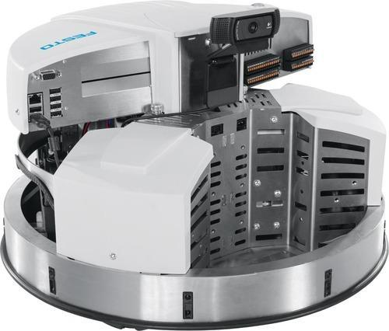
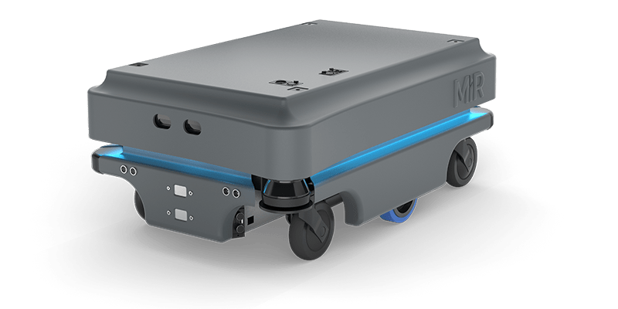
Multi-Robot Simulation
Usability & CPU Usage Evaluation

Slide 2
Multi-Robot Simulation-Evaluation Sheet
# of Robots | GZ Server | GZ Server | GZ Client | GZ Client | RAM | CPU | T.F | T.F
 | CPU | Memory | CPU | Memory |  |  | Average | Min
1 | 8.5 | 2.1 | 27 | 3.9 | 23 | 44 | 0.98 | 0.94
3 | 18 | 2.21 | 28 | 4.24 | 28 | 70 | 0.94 | 0.88
5 | 29 | 2.4 | 26 | 4.7 | 31 | 88 | 0.89 | 0.83
6 | 29 | 2.5 | 26 | 4.9 | 33 | 81 | 0.75 | 0.65
7 | 29 | 2.65 | 26 | 5 | 34 | 92 | 0.7 | 0.62
8 | 29 | 2.7 | 27 | 5.28 | 36 | 93 | 0.6 | 0.52
9 | 31 | 2.7 | 27 | 5.6 | 37 | 93 | 0.55 | 0.44
10 | 31 | 2.74 | 27 | 5.8 | 40 | 94 | 0.52 | 0.41

Slide 3
Usage of Gazebo

Slide 4
Time Factor Dialation

Slide 5
Total CPU Usage

